Slide 1
Python Full Stack
By: Pravesh Mishra
(Full Stack developer )

Slide 2
Internet
Internet is a global network of interconnected computers that allows for the exchange of information and data. It is a public network, accessible to anyone with an internet connection. The Internet is made up of millions of smaller networks, including local area networks (LANs) and wide area networks (WANs).
Note : internet is tha collection of more than networks

Slide 3
What is www(World Wide Web )
www stands for World Wide Web. It is a global system of interconnected hypertext documents accessed through the Internet. It is a way to access information and resources on the internet.
hypertext is a text that contains links to other text, allowing for easy navigation and exploration of information.

Slide 4
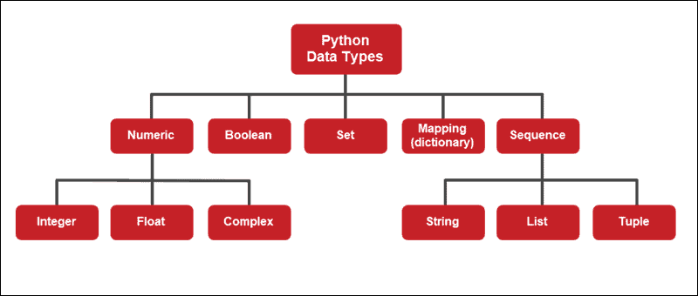
What is data ?
Data is information that is processed by a computer. It can be numbers, text, images, audio, video, or any other form of information that can be stored, transmitted, or analyzed

Slide 5
Data type In Python
Python is a dynamically typed language, which means you don't need to explicitly declare the data type of a variable when ¹ you create it. The interpreter automatically determines the type based on the value assigned to it.

Slide 6
Versions of Python
Python Programming Contains 3 Types of Versions. They are 1. Python 1.x Here 1 is called Majot Version and x Represents 1 2 3 4 5 6 called Minor Version
As on today Python1.x Outdated
Python 2.x does not support Backward compatability with Python 1.x

Slide 7
2. Python 2.x Here 2 is called Major Version and X Represents 1 2 3 4 5 6 7 Called Minor Version
As on today Python2.x Outdated
Python 3.x does not support Backward compatability with Python 2.x

Slide 8
Python 3.x Here 3 Is called Major Version
Current Version and x Represents 1 2 3 4 5 6 7 8 (Old Version) 9 10 11 (Old Version, still Continued--MNC)-Secured
12 (New Version)--Bug Fix
13 (Latest Version)--Bug Fix
14 (Future OR PreView Version)--2025 Octm

Slide 9
Downloading and Intallation Procedure of Python
=>Goto www.python.org
=>Choose downloads---- Click on python 3.13
=>After downloading, start Installing

Slide 10
Features of Python Programming Languag
Features of Language are nothing but Services OR Facilities Provided by Language Developer and they are avialable in Langauages and They are used by Lang Programmers for Developing Real Time applications.
Python Programming Provides 11 Features. They are

Slide 11
1. Simple
2. Platform Independent Lang
3. Dynamically Typed
4. Interpreted
5. High Level
6. Robust(Strong)
7. Functional and Object Oriented
8. Embedded
9. Extensible
10. Supports Third Party Modules Such Numpy,Pandas, Matplotlib
11. Freeware and Open Source

Slide 12
Why ptyhon is simple
Python is known for its simplicity and readability. Its syntax is clean and easy to understand, making it a great language for beginners and experienced programmers alike. Key factors contributing to its simplicity include:
Readability: Python code is designed to be human-readable.
Indentation: Python uses indentation to define code blocks, making the structure visually clear.
Dynamic Typing: Variables don't require explicit type declarations.
Large Standard Library: Python comes with a rich library of modules for various tasks.
Active Community: A large and supportive community provides resources and assistance.

Slide 13
What is Platform Independence:
The ability of software to run on different operating systems, hardware, or devices without significant modifications
Yes, Python is platform-independent. This means that Python code written on one operating system (like Windows) can be executed on another operating system (like macOS or Linux) without any major modifications.

Slide 14
Python code is interpreted, not compiled.
The Python interpreter is available for multiple platforms.
This makes Python platform-independent.
Benefits: Portability, efficiency, cost-effectiveness, wider reach.
Approaches: Cross-platform languages, virtual machines, web-based applications.

Slide 15
Dynamically Typed Languages:
Data types are determined at runtime.
No explicit type declaration needed.
Flexible, but can lead to runtime errors.
Examples: Python, JavaScript, Ruby, PHP.

Slide 16
Interpreted Programming Language:
Code is executed line by line, without compilation.
Interpreter translates code into machine instructions.
Advantages: Platform independence, faster development, easier debugging.
Disadvantages: Slower execution, dependency on interpreter.
Examples: Python, JavaScript, Ruby, PHP.

Slide 17
Python as a High-Level Language:
Abstraction: Hides low-level details of hardware and machine code.
Human-readable syntax: Easier to read and write.
Automatic memory management: Reduces programmer burden.
Large standard library: Provides modules for various tasks.
Cross-platform compatibility: Can run on different operating systems.

Slide 18
Robust Features of Python:
Dynamic Typing: Flexible data type handling.
Large Standard Library: Rich set of modules for various tasks.
Object-Oriented Programming (OOP): Supports inheritance, polymorphism, and encapsulation.
Community and Ecosystem: Active community and extensive resources.
Cross-Platform Compatibility: Runs on different operating systems.
Readability: Clear and concise syntax.
Memory Management: Automatic garbage collection.
Metaprogramming: Ability to modify code at runtime.
Integration with Other Languages: Can be used with C/C++ for performance-critical tasks.
Versatility: Suitable for a wide range of applications (web development, data science, automation, etc.).

Slide 19
Functional and Object-Oriented Features of Python:
Functional Programming:
Immutability: Emphasis on immutable data structures.
First-Class Functions: Functions can be treated as values, passed as arguments, and returned as results.
Higher-Order Functions: Functions can take functions as arguments or return functions.
Pure Functions: Functions that produce the same output for the same input and have no side effects.
Lambda Expressions: Anonymous functions defined in a single line.

Slide 20
Object-Oriented Programming:
Classes: Blueprints for creating objects.
Objects: Instances of classes, representing real-world entities.
Attributes: Data associated with objects.
Methods: Functions defined within classes.
Encapsulation: Hiding internal implementation details.
Inheritance: Creating new classes based on existing ones.
Polymorphism: Ability of objects of different types to be treated as if they were of the same type.

Slide 21
Embedded Features in Python
Embedded features in Python refer to the capabilities that allow Python to be integrated with other systems or devices. This can include:
Hardware Interaction: GPIO, SPI, I2C
Real-Time Systems: MicroPython, CircuitPython
System Programming: ctypes, Pygame
Network Programming: Sockets, IoT

Slide 22
Extensible features in Python
Extensible features in Python refer to its capabilities that allow it to be customized and expanded to meet specific needs. This includes:
Modules and Packages: Organize code into reusable components.
Custom Classes and Objects: Create custom data structures and behaviors.
Metaclasses: Modify the behavior of class creation.
Decorators: Add functionality to functions without modifying their source code.
Context Managers: Manage resources efficiently.

Slide 23
Supports Third Party Modules
Supports third party Modules Such Numpy,Pandas, Matplotlib
Python, there are three main types of modules:
Modules
User-Defined Modules:
Built-in Modules:
Third-Party Modules

Slide 24
Freeware and Open Source
Freeware and Open Source are terms often used to describe software that is freely available. However, they have distinct characteristics and implications.
Freeware
Software that is freely available without requiring payment.
Open Source
Software whose source code is freely available for modification and redistribution.

Slide 25
Plateform Depandent Language
Example :-c,c++
Languages that require specific hardware or software environments to run.
Assembly language, C (when not using cross-compilers), Fortran. Are example plateform, depandent language

Slide 26
Plateform independent language
Example :-java python
Languages that can run on multiple platforms without significant modifications.
Java, Python, C#, JavaScript, Ruby. Are plateform independent language

Slide 27
Python Programming Exec Envionment.
Python Programming Exec Environment
A software environment for executing Python code.
Includes Python interpreter, text editor, libraries, and virtual environments.
Benefits: Organization, efficiency, portability, consistency.

Slide 28
Data type
Type of data is called data type
To allocate suff amount memory space in main memory (RAM) of computer for storing Inputs
Data Type Name
Int
Float
Double
Char
Boolen
Import Keyword
Conclison : hans c ,c++ languauge is called plateform dippendent language
ms dos Int -2 byte Float -4 byte Double -8 byte char -1 byte | Unix 4 8 16 1 Byte

Slide 29
Key word
Keyword is a module
Code to list tha keywords in python
For a

